Slide 1

IBM Watson Analytics
Andrea, Daniel, Johan, Mai, Salah

Slide 2
CFO
Driving and forecasting organic growth whilst ensuring profitability
CFO KPIs
KPI | Rationale | Action
% Profit Margin per Country, Product Category, Store | Tracking the performance of different segments and markets | Derived from profit and revenue
% Organic Revenue Growth, Q-o-Q | Ensuring added value is being created internally in sustainable manner | Forcasting using ARIMA-models
% Growth in Market Share | Market Share of cities calculated as nr of customers/population | Use clustering to decide where new stores should be opened up

Slide 3
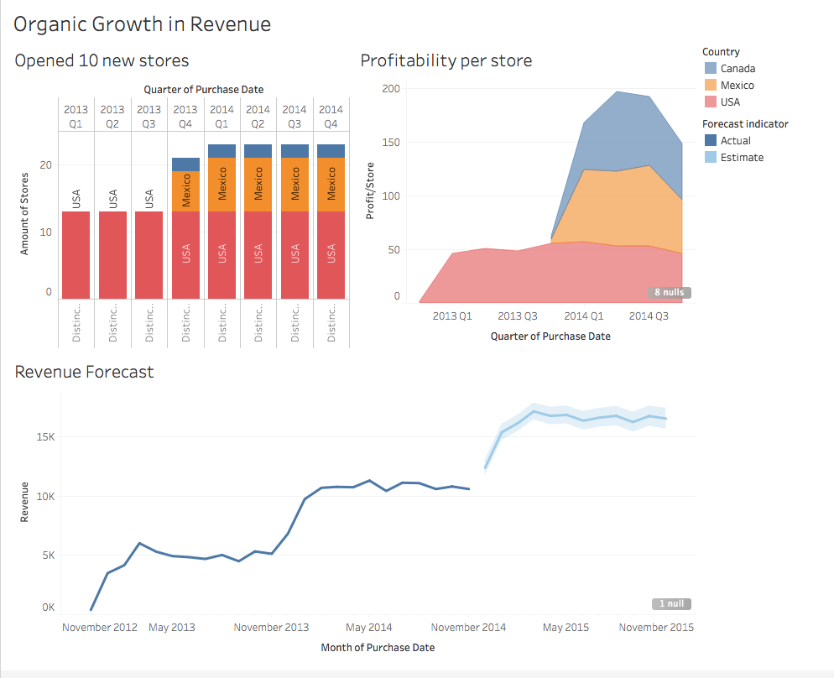
Notes:
Opened 10 new stores between Q4 2013 –Q1 2014
Doubled our revenue and profits
Profiability/store for US remained constant, Canada and Mexico showing real potential

Slide 4
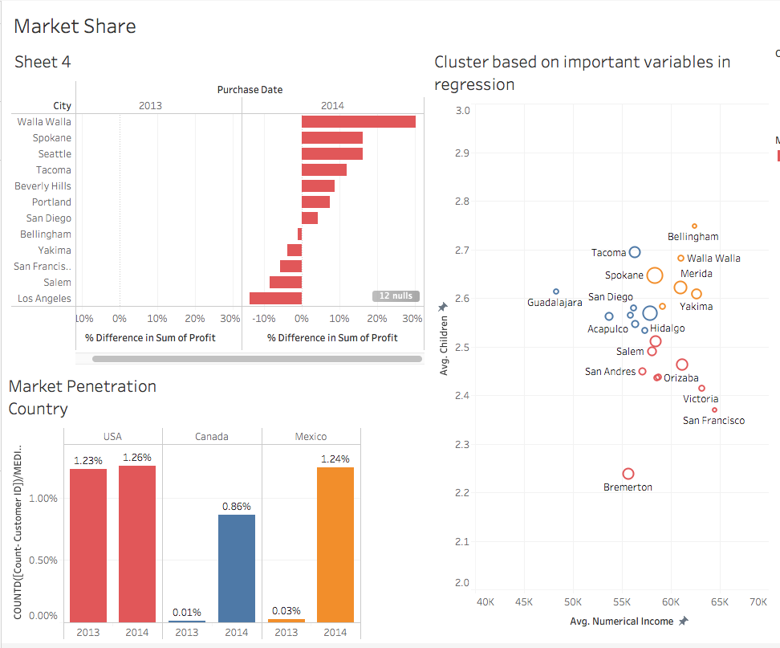
Notes:
Opened 10 new stores between Q4 2013 –Q1 2014
Doubled our revenue and profits
Profiability/store for US remained constant, Canada and Mexico showing real potential

Slide 5
Sales Manager
KPI | Definition
Monthly sales by region | Measures how much money your retail business make each month. This can be compared with monthly targets and with estimated sales from the competition to assess the performance of each region.
Average customer spending | Measures how much each customer spends in the store during a given period. A high value is an indicator of customer engagement and satisfaction.
Profits by category | Measures the benefits for each product category. This can be helpful when deciding which products the company wants to carry, which categories produce the most money, and which categories need a boost from marketing to achieve the set targets.
Responsible for overall sales performance across all regions. Their objectives are achieved through effective planning, setting of sales goals, analyzing data on past performance, and projecting future performance.

Slide 6
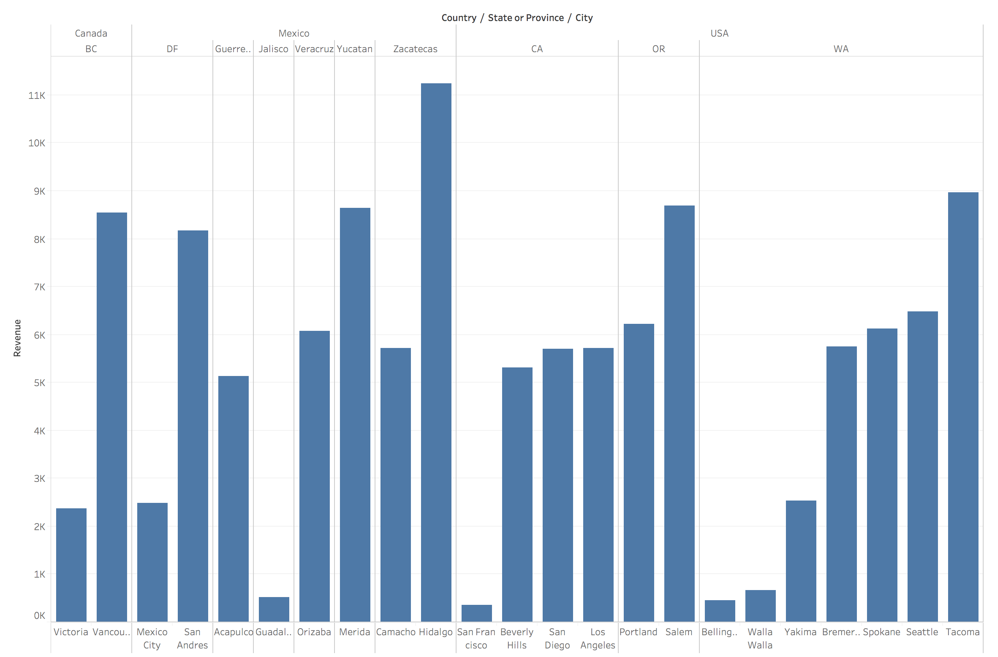
Yearly sales by region (2014)

Slide 7
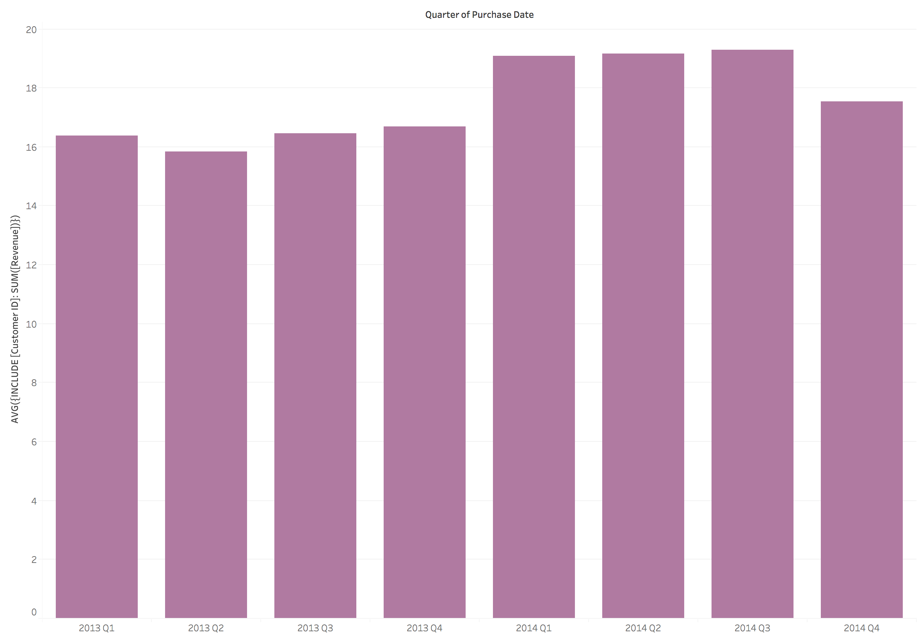
Average customer spending (by quarter)

Slide 8
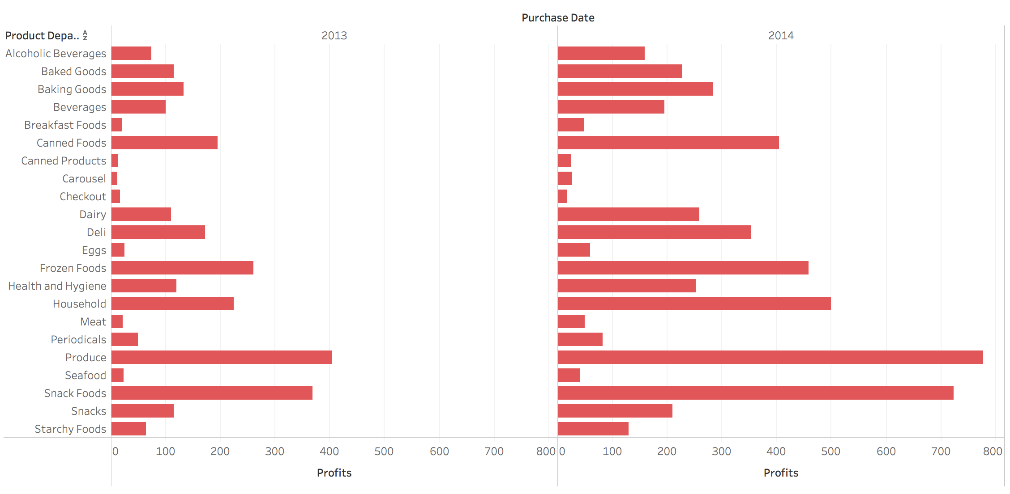
Profits by category (2013 & 2014)

Slide 9
Chief Marketing Officer
KPI | Intuition | Analysis
Retention Rate | Tracking if customers come back after a purchase in the following months | Cohort analysis
Units Sold | Bundling products to increase units sold for a purchased product & shelving products frequently purchased together near each other | Market basket analysis to analyse which products are most purchased together
Avg. Visits/Customer in each city | Tracking where customers are frequent visitors to develop pilot loyalty program | Using number of unique visits and number of unique customers
Objective: Understand how our customers interact with our stores and products to better target them

Slide 10
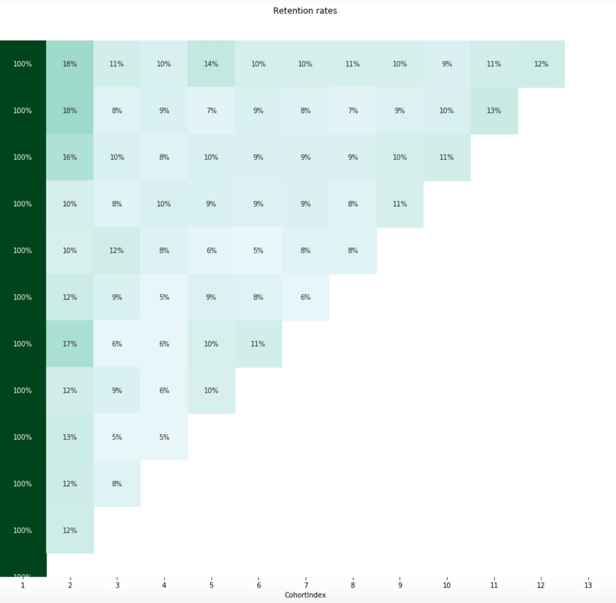

Slide 11
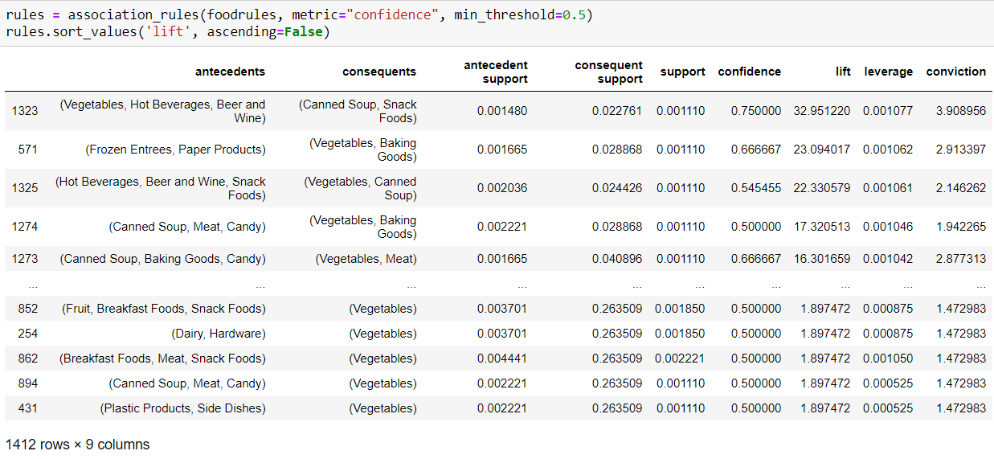
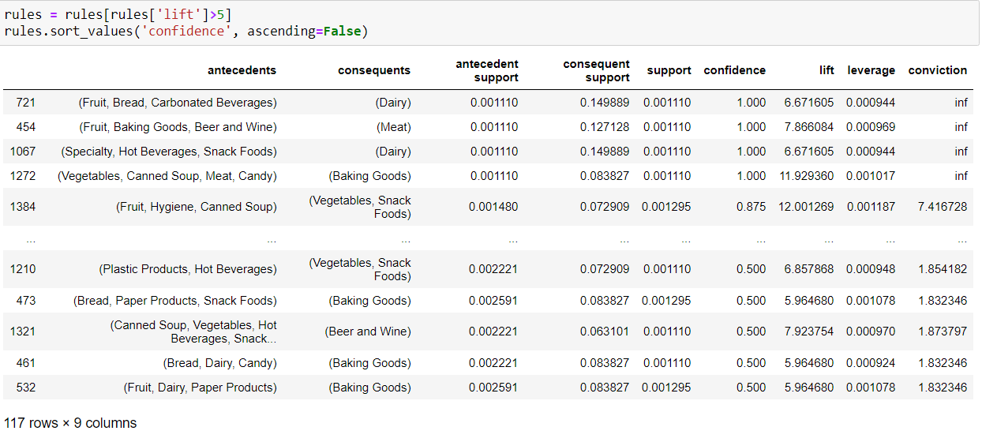
Market Basket Analysis
Notes:
Make bundles out of the

Slide 12
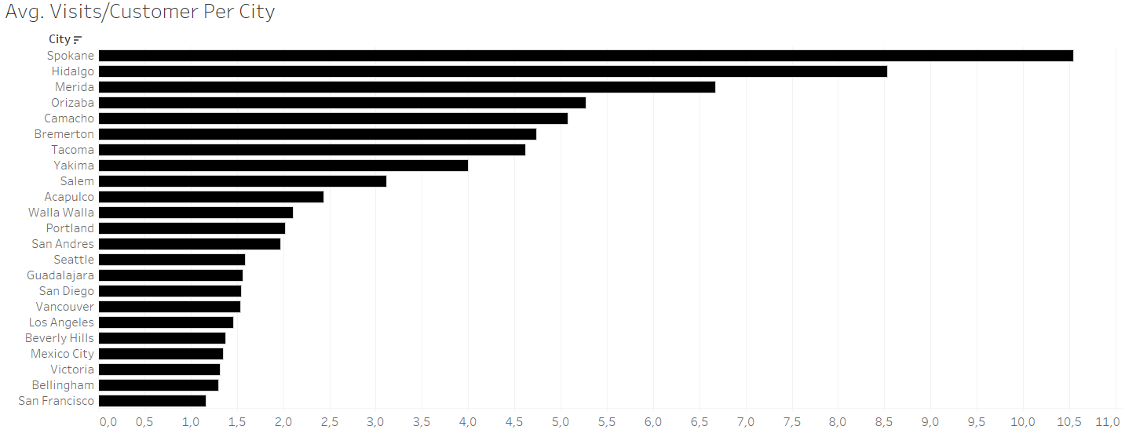
Customer Profiles

Slide 13
Average visits per customer in every city
Top 5
Lowest 5
Spokane
Beverly Hills
Hidalgo
Mexico City
Merida
Victoria
Orizaba
Bellingham
Camacho
San Francisco
Notes:
Make bundles out of the

Slide 14
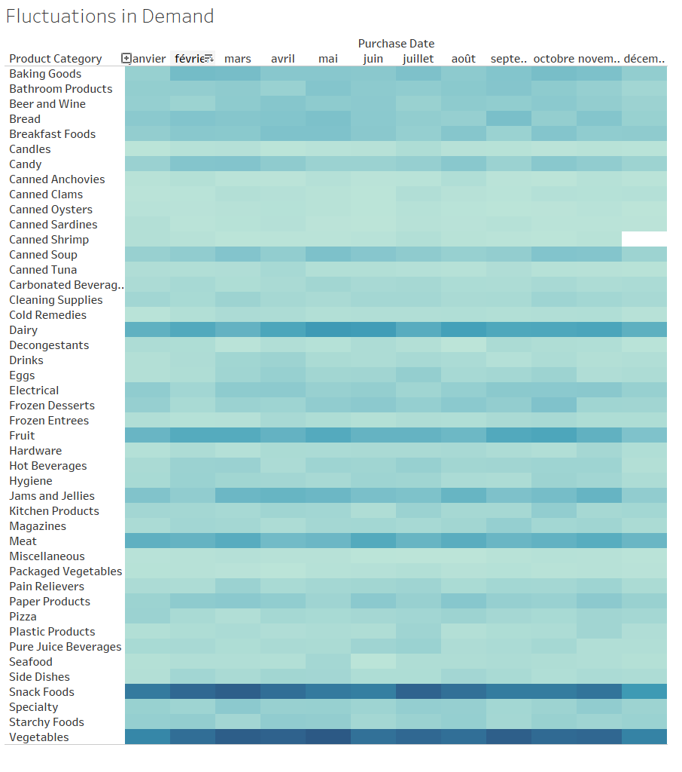

Slide 15
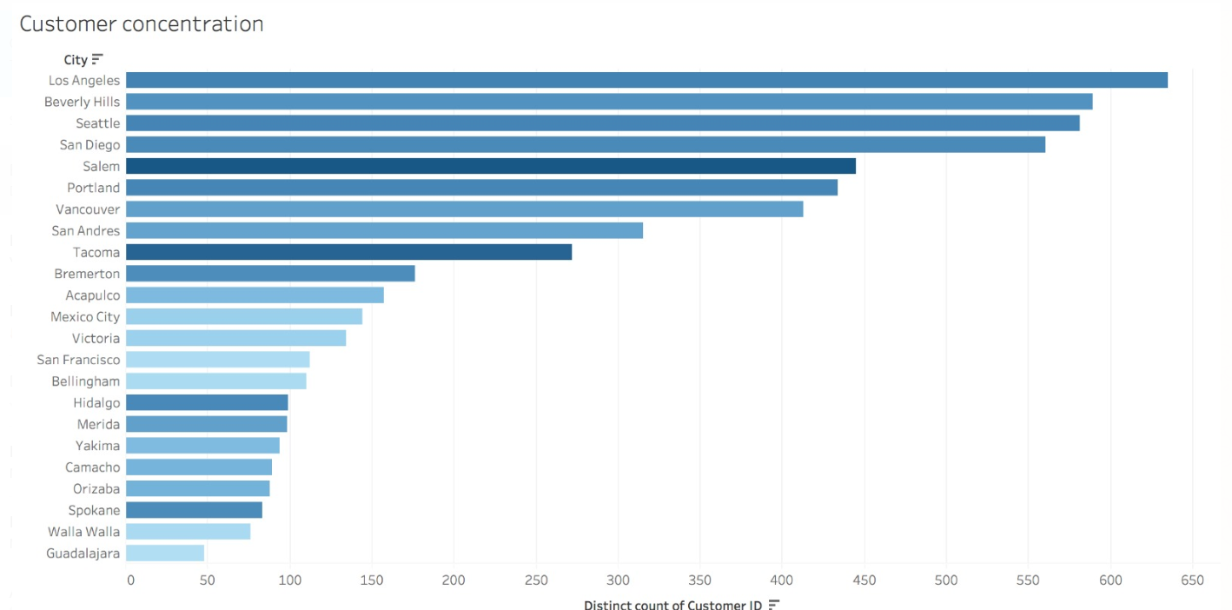
Customer concentration KPI: Footfall

Slide 16
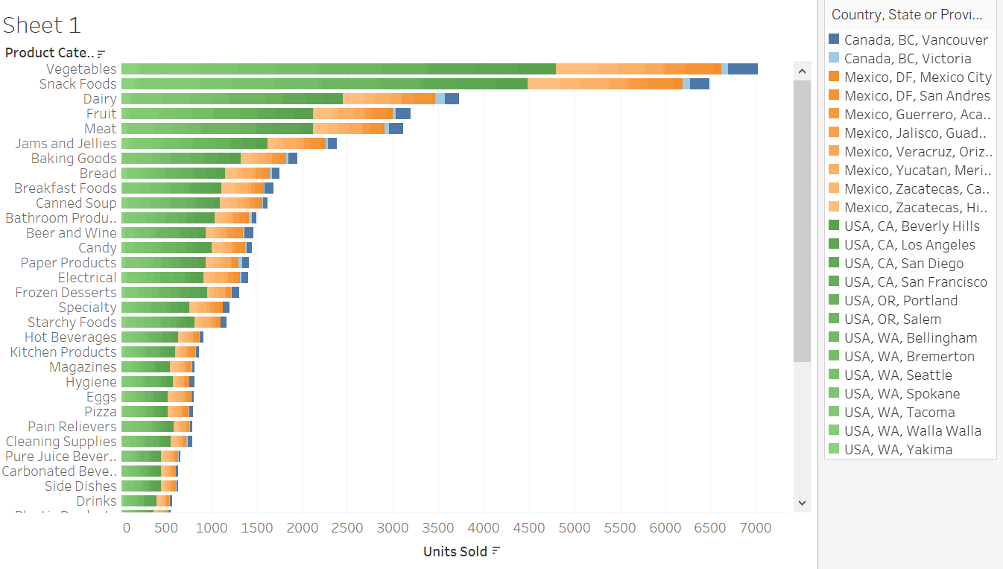
Category Manager: FOOD
KPI: Ensure product availability
Goal: Make sure customers are able to get products they need
Analytics: Distribute products accordingly to the demand in each city/state

Slide 17
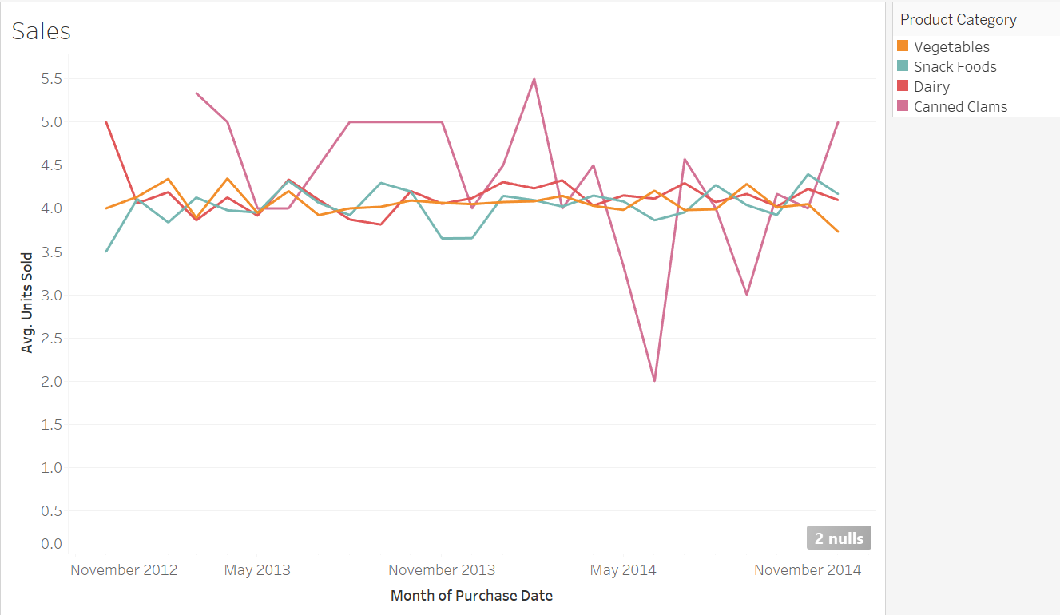
Category Manager: FOOD
KPI: Optimize sales accordingly
Goals: Adjust sales strategies based on forecasting results
Analytics: Forecast sales for each season based on units sold

Slide 18
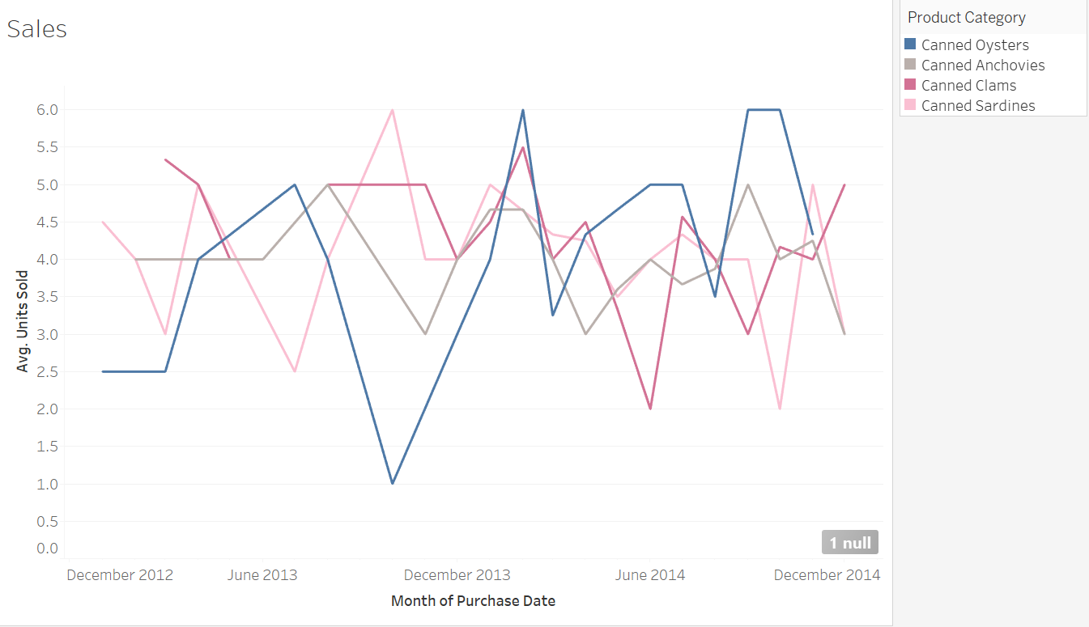
Category Manager: FOOD
KPI: Design strategies for unsuccessful products
Goal: Boost sales of unsuccessful products
Analytics: Find out which products are unsuccessful by displaying product sales

Slide 19
As a Store Manager, I oversee the daily operations of my store, ensuring it runs efficiently and in accordance with corporate tactical and strategic decisions
Store: Salem
KPI | Rationale | Action
Sales Target | As Salem is the highest selling store both in terms of units and revenue, it will be used as a benchmark and example for other stores. It must continue growing and maintain it’s position. | Use Forecasting techniques to evalute whether the sales target set is reasonable. Use corrective measures if needed.
Average Spend | The average spend of customers is slightly above average, but there is still room for improvement. | Market basket analysis to create promotion to cross sell, and increase average basket size.
Unique customers | Despite performing well under this KPI, the store with the highest number of unique customers has roughly 30% more unique customers than the Salem store. There is room for growth in this aspect. | Customer segmentation to discover ”golden” customers, and target potential customers with similar attributes with promotions to attract them based on purchase history. (Done to show that we can meet customer expectation even before meeting them).

Slide 20
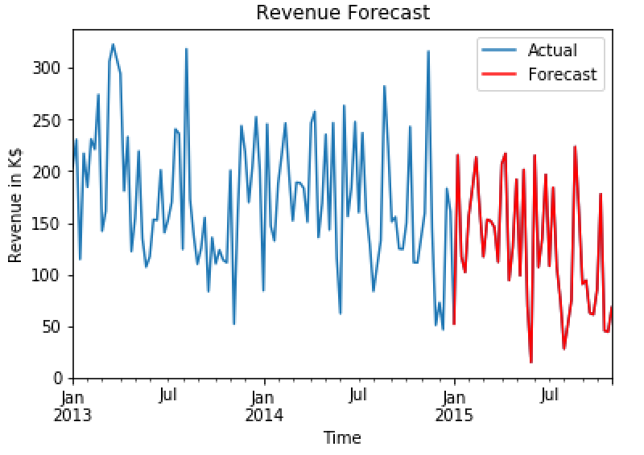
Revenue has a downward trend in the last year, meaning we will likely not meet the sales target as is

Slide 21
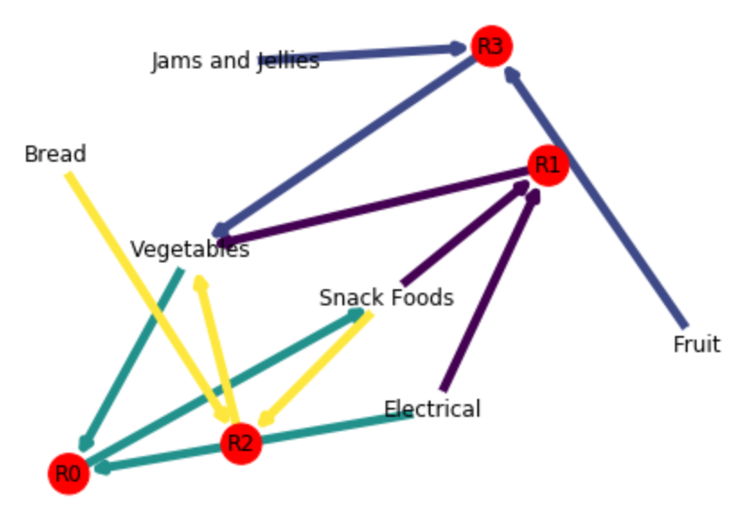
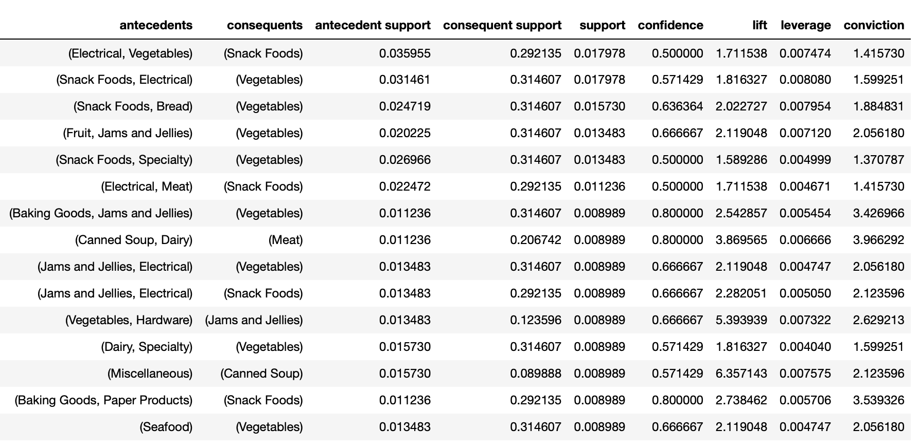
To increase average spend and basket size, we should focus our marketing efforts on vegetables and snack foods

Slide 22

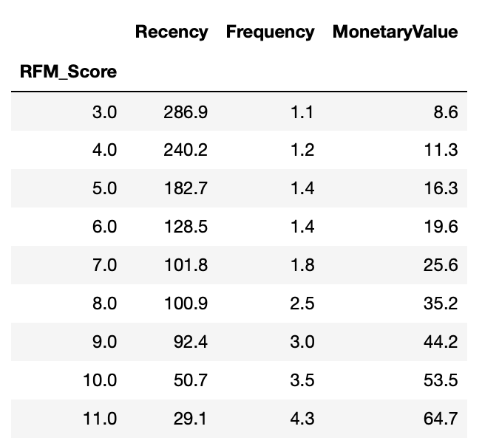
To increase sales and unique customers, we should target customers similar to our top selling customers, who spend 64$ per visit

Slide 23
THANK YOU

Slide 24
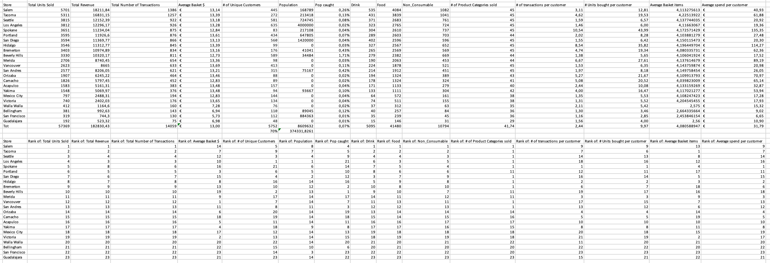
Appendix Store Manager

